Slide 1
METC 111
Lab Note-book
Sue Hlaing

Slide 2
Lab-1
Hooke’s Law-Measuring Force

Slide 3
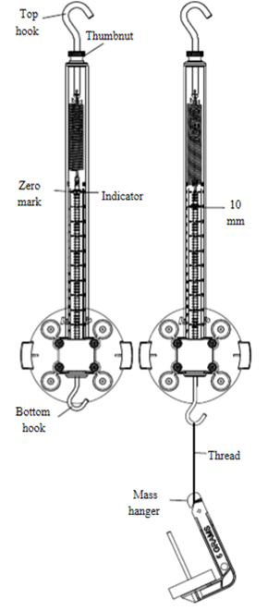
Measuring Force Data
10 different amounts of weight applied to the spring.
The spring displacement was then measured.
This information was used to find the force applied to the spring.
We found that the spring constant “k” could be calculated without use of hooks law.
The graph starts from the origin because the spring was zero's out prior to starting the lab.

Slide 4
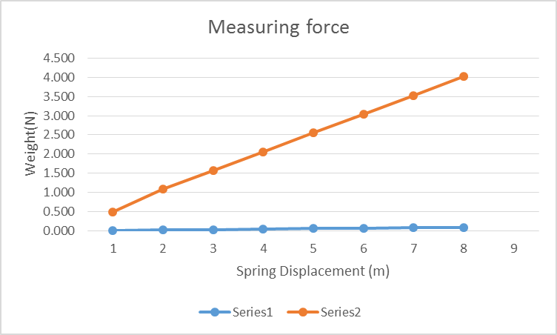

Slide 5
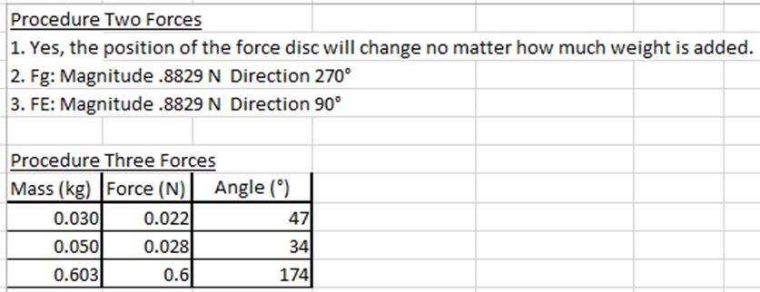
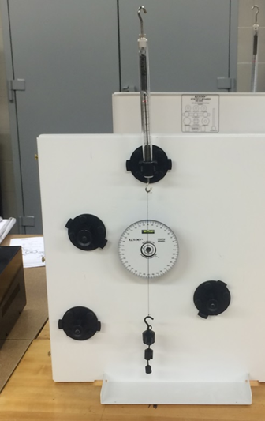
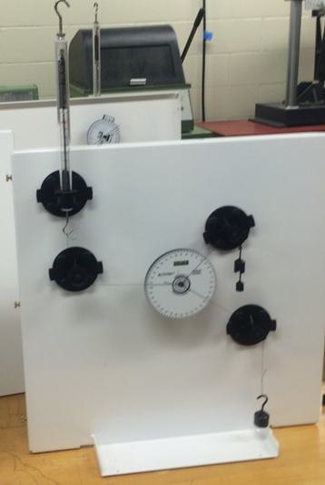
Lab 2-Adding Forces – resultants and Equilibrants
Items used: spring scale, pulleys, force wheel, and weights
Testing was done on two different systems shown as procedure two and procedure three below.

Slide 6
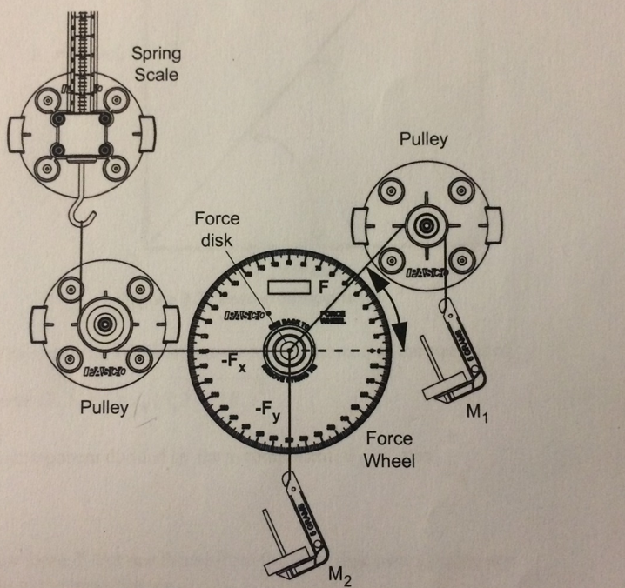
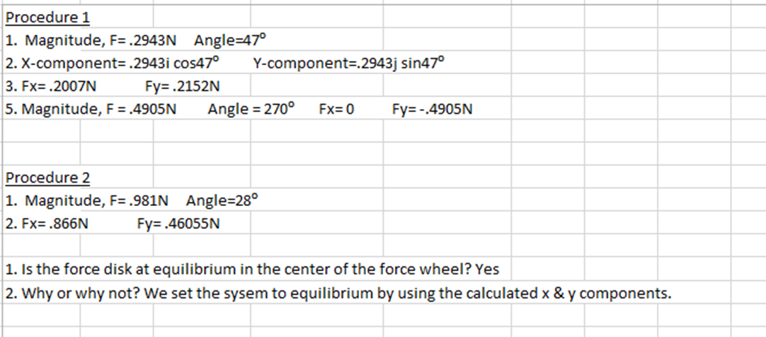
Lab-3:Resolving Forces-components
Items used: spring scale, pulleys, force wheel, and weights
Testing was done on two different systems shown as procedure one and procedure two below.

